Slide 1


Slide 2
YEAR 9
GCSE CHOICES
Imagine Your Future

Slide 3
2.38 million students studying at UK higher education institutions.
CHOOSING YOUR
GCSE OPTIONS
How do I make the right choices?
How many will I do?
Year 9
What are the core subjects?
What will
I study?

Slide 4

2.38 million students studying at UK higher education institutions.
NOT ME
ME
Starter Questions
SHOW OF HANDS
Who already has a good idea what subjects they’d like to study?
Who needs some help with
their choices?
1.
ME
2.
NOT ME

Slide 5
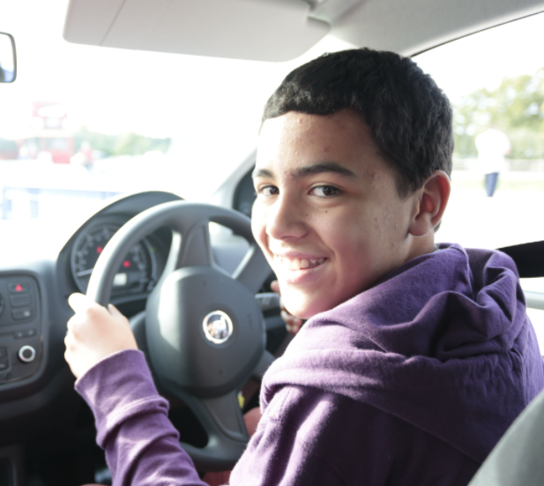
This is an exciting time in your school life where you can start to shape your education by choosing to focus on the subjects you like most and do well.
GCSE’S set you up for further study, teach you how to learn and give you valuable transferable skills such as communication, problem solving,
team work and responsibility.
You’re in the driving seat

Slide 6
2.38 million students studying at UK higher education institutions.
Let’s start
by thinking
BIG
Finding your
IKIGAI activity

Slide 7
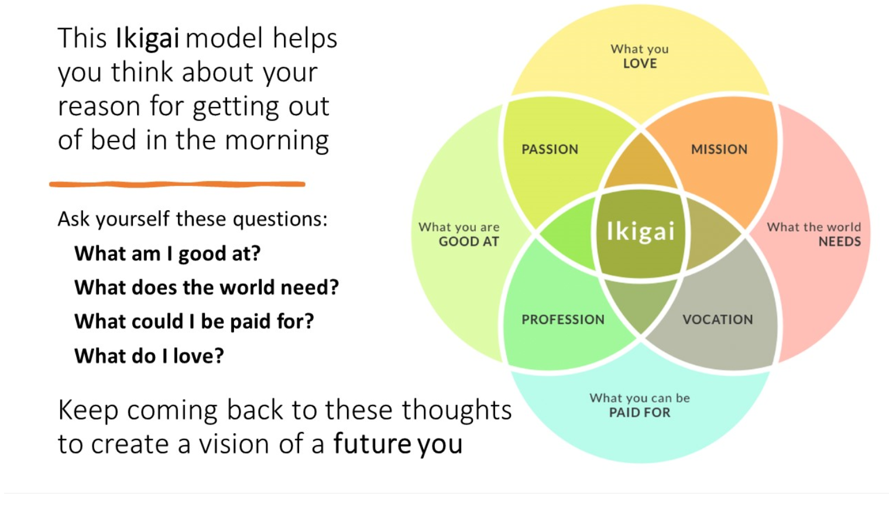
Ikigai
Finding your purpose.
Japanese word and idea: that you feel physically and emotionally balanced when you’re doing what you love.

Slide 8


What I love
People
Creativity
Variety
Example:
from Rachel Lillywhite WIN Project Officer
What I’m good at
Designing
Creativity
Listening
Supporting others
What the
world needs
More acceptance
More co-operation
BIG IDEAS!
What can I be paid for?
Creating workshops
Guiding young people

Slide 9
Share with your teachers.
How could this task influence your choices?
Complete the worksheet
Try finding YOUR Ikigai
What I love?
What the world needs?
What I’m good at?
Write in the circles
TRUST YOUR INSTINCTS!!
What I can be paid for?

Slide 10
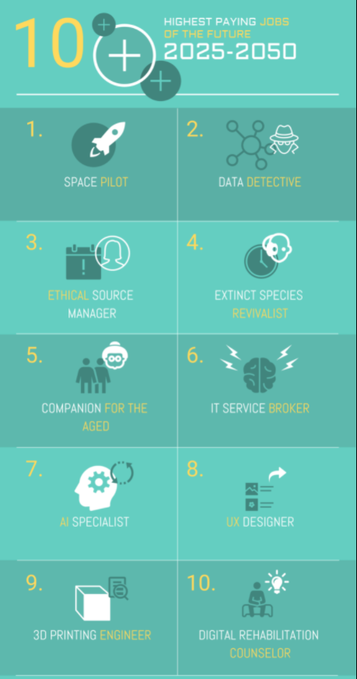

How could your Ikigai help you identify a future job?
What’s YOUR job of the future?
Discussion

Slide 11
2.38 million students studying at UK higher education institutions.
GCSE’S
THE FACTS
Watch the video

Slide 12

OR CLICK HERE TO WATCH

Slide 13
2.38 million students studying at UK higher education institutions.
YOUR LEARNING JOURNEY
Your future pathway
Options discussion
What options do
I have in the next few years?

Slide 14
LEVEL 1/2
LEVEL 3
LEVELS 4/5/6/7/8
THE REST OF
YOUR LIFE
YEAR 9
YEAR 10/11
YEAR 12/13
HIGHER EDUCATION
SCHOOL
SCHOOL
SCHOOL OR
FE COLLEGE
UNIVERSITY OR COLLEGE
WORK
Year 9
(Options)
GCSE’S
A levels
HNC / Higher Apprenticeship
Work and study
(on-going)
Advanced Apprenticeship
Work and training
(on-going)
Foundation Degree / Dip HE
NVQ
HND / Degree Apprenticeship
BTEC Certificate
1 yr
PGCE - Teaching
YOU’RE
HERE
Bachelors Degree
BA / BSC
BTEC Diploma
2yrs
Masters Degree
MA
T Levels
Doctorate PHD

Slide 15
You may decide to study A Levels after you’ve finished your GCSE’s. Or you might go on to college and take a BTEC, T level, Apprenticeship or other qualifications that are right for you.
You may decide to progress to Higher Education. This is your degree level learning after you leave school or college, aged 18.
You can study at a university or college or do an apprenticeship where you work (and study).
Your onward learner journey:
Don’t worry, all schools and colleges have experienced Careers Advisors who can help with your choices.

Slide 16
2.38 million students studying at UK higher education institutions.
POSSIBLE JOBS
AND SKILLS
Thinking ahead
Jobs quiz
Do you think YOU would be good at any of these jobs?
Why?
What GCSE’S would be useful for these jobs?
Why?

Slide 17


I’m a trained climber
I have to be
health and safety aware
GUESS MY JOB?
I work in a
small team
I work outside in
all weathers

Slide 18
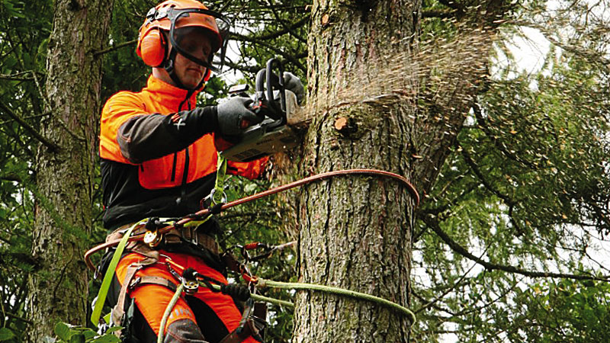
TREE SURGEON

Slide 19


I need a degree
for this job
I need to take accurate notes
and records
GUESS MY JOB?
I work with
parents
I work in a busy and noisy environment

Slide 20
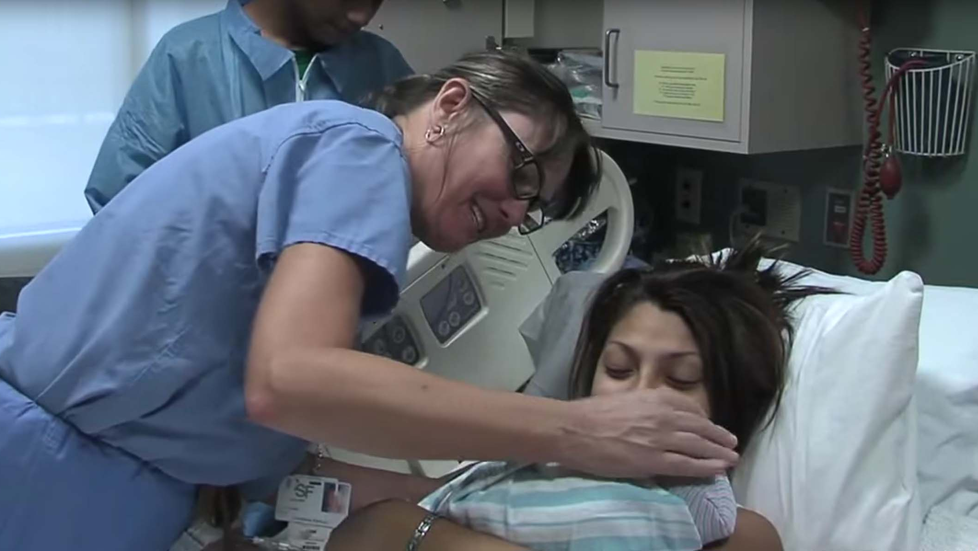
MIDWIFE

Slide 21

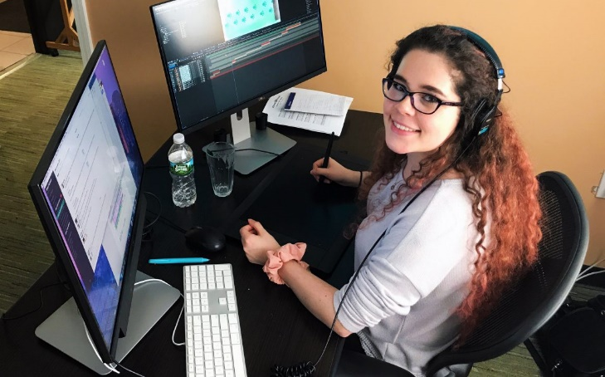
I work mainly on my own at home/office
I’m creative
GUESS MY JOB?
I have excellent
IT skills
I bring characters to life

Slide 22
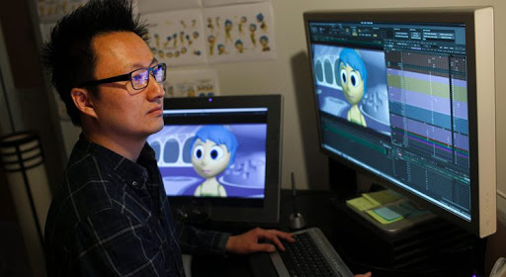
ANIMATOR

Slide 23
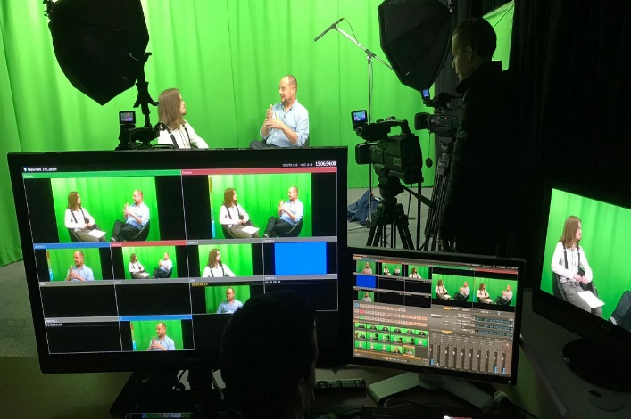

I travel and meet lots of new people
I make lots of decisions
GUESS MY JOB?
I manage a creative and diverse team
I’m a skilled
multi-tasker

Slide 24
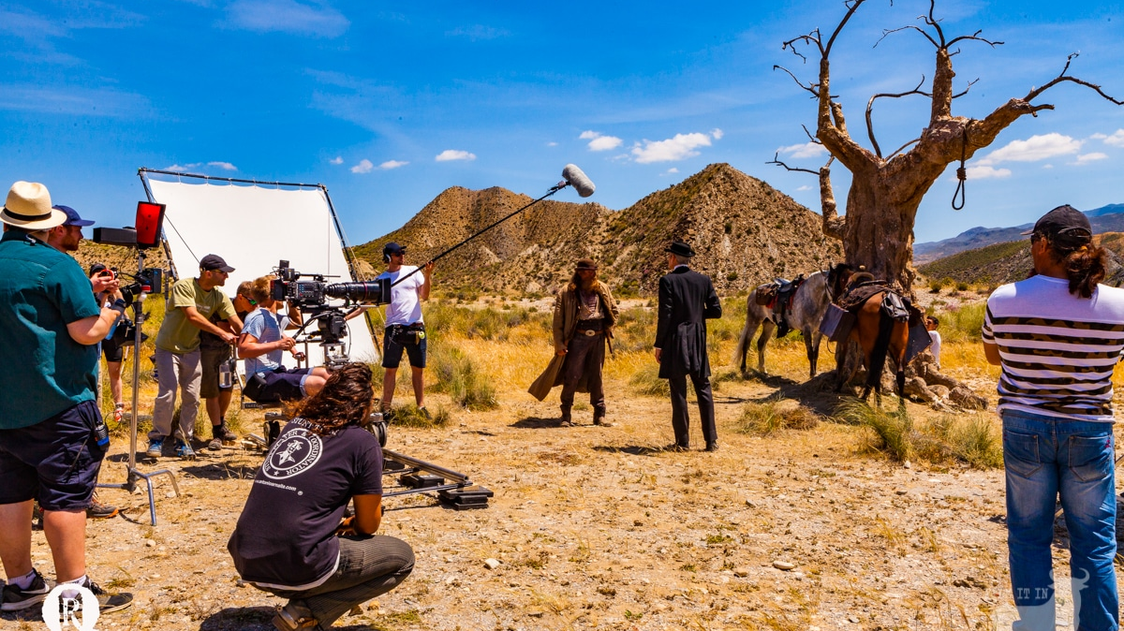
TV & FILM PRODUCTION MANAGER

Slide 25
2.38 million students studying at UK higher education institutions.
TRUE OR FALSE QUIZ
How much do you know?

Slide 26
Uni’s look at your GCSE grades when deciding to offer you a place?
True
Stormzy achieved 6 A* at GCSE?
True
Maths, English and Science GCSE are compulsory?
True
TRUE OR FALSE DISCUSSION:
You have to take at least 9 GCSEs?
False
History is a Humanities subject?
True
Taking Art GCSE is a good idea because it is an easy option?
False
If you want to study medicine at university you must take Biology GCSE?
False

Slide 27
2.38 million students studying at UK higher education institutions.
HINTS AND TIPS TO
HELP YOU DECIDE
Watch the video
GOOD LUCK!

Slide 28
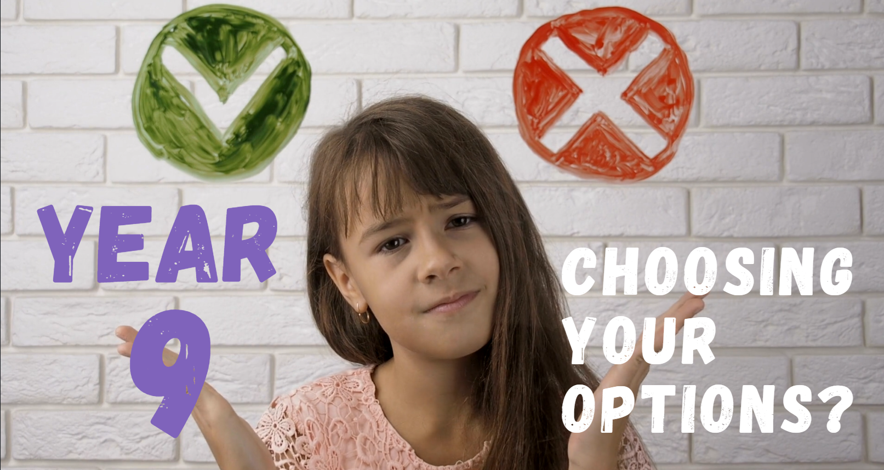
OR CLICK HERE TO WATCH

Slide 29
GCSE - BBC Bitesize
Careerpilot : Get information : GCSEs : Choosing your GCSEs
Careerpilot : Jobs by subject
Careerpilot : My skills profile
USEFUL LINKS:

Slide 30



@win_wessex1
@WINWessex1
www.facebook.com/WINSUPPORTtogether
Disclaimer. Each ‘Lesson in a Box’ comes with a feedback form for you to complete. We ask that all who request and deliver a Lesson in a Box to complete this feedback form to ensure that we are providing the highest quality resources possible.
Please note, we may contact you if we have not received a response on this feedback after a certain amount of time.

