Slide 2
PRE-16
WRITING A SUCCESSFUL CV
Preparing for your future

Slide 3
2.38 million students studying at UK higher education institutions.
I’m great at art!
What are my skills?
Session 2
IDENTIFYING YOUR
SKILLS AND PERSONAL QUALITIES
HOBBIES AND INTERESTS
DO’S AND DON’T’S
WORK RELATED ACTIVITIES
I’m good at team work
What are my qualities?

Slide 4
Raising money for charity?
Training an animal or pet?
Preparing and cooking meals?
All the things that you do in and out of school are part of your SELF-DEVELOPMENT and give you KEY SKILLS you can highlight on your CV
HANDS UP IF
you’re already…?
Planning events?
Passionate about protecting our planet?
Wanting to change the world?
Drawing and painting?
Open to trying new things?
Playing an instrument?
Playing a team sport?
A leader or a captain?
Good at encouraging others?
Interested in the news?
Understanding what help other people might need?

Slide 5
Wanting to change the world
Drawing and painting
Now choose 3 of your TOP skills from the images here
Playing a team sport

Slide 6
Skills and personal qualities Teamwork: I play for my local football team and volunteer to wash the kit. Speaking: I think the world needs urgent action on climate change so I gave a presentation to my geography class on how we can change our everyday behaviour. Creativity: I’m good at drawing and painting and do a drawing a day in my sketch book of ideas.
Now describe HOW you use these skills.
Add this to your CV template here:

Slide 7
DON’T FORGET TO MATCH YOUR INTERESTS TO THE JOB

Slide 8
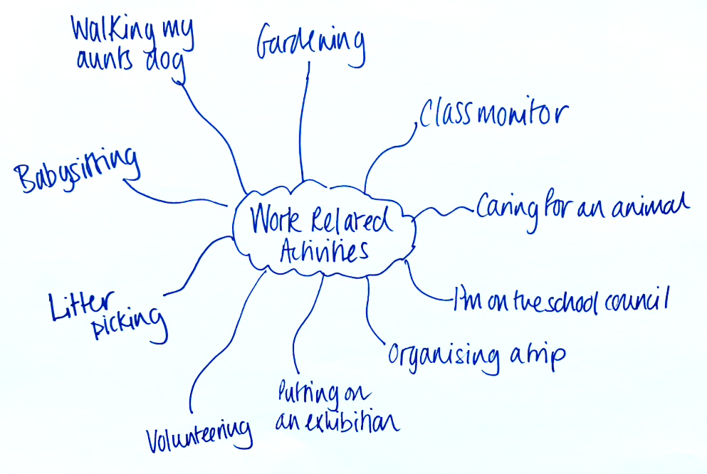
You may be doing ‘work related’ activities that you aren’t paid for but are preparing you for the responsibility of work.
You’re at the start of your work journey
Brainstorm all the work related activities that you’re doing
Don’t worry if you only have one or two things to write down, you will add to these over time as you start to discover more opportunities.

Slide 9
Now write them in your CV template here:
Employment and work experience Type of work: Community Support, help for the elderly. Job duties and responsibilities: I help an elderly neighbour with their weekly shopping. Type of work: Dog walker Job duties and responsibilities: I walk my aunt's dog once a day and am responsible for booking his monthly grooming session. Type of work: Babysitter Job duties and responsibilities: I babysit for my 4-year-old nephew twice a month.

Slide 10
Personal profile / statement
Curriculum Vitae means ‘Course of Life?’
You have the same CV throughout your whole career?
CLICK TO REVEAL
Agree / disagree game
A covering letter is as important as a CV?
You MUST always tell the truth on your CV?
Resume is another word for CV?
The average time an employer looks at a CV is 30 seconds?
If an employer sees a spelling or grammar mistake on your CV they’ll reject it?
Employers will reject your CV if your email address is unprofessional?

Slide 11
Personal profile / statement
Useful links:
Barclays Life Skills CV builder
Barclays Life Skills dictionary of skills
Register with Careerpilot to build your skills profile
CV Templates
Useful links

Slide 12
Thank you
Teachers
CLICK HERE
to give us your feedback

Slide 13
@win_wessex1
@WINWessex1
www.facebook.com/WINSUPPORTtogether
Disclaimer. Each ‘Lesson in a Box’ comes with a feedback form for you to complete. We ask that all who request and deliver a Lesson in a Box to complete this feedback form to ensure that we are providing the highest quality resources possible. Please note, we may contact you if we have not received a response on this feedback after a certain amount of time.

