Slide 2
PRE-16
WRITING A SUCCESSFUL CV
Preparing for your future

Slide 3
2.38 million students studying at UK higher education institutions.
What do I include?
What is a CV?
Session 1
CV CONTENT & STRUCTURE
WRITING A
PERSONAL PROFILE
How do
I start?
What does it look like?

Slide 4
2.38 million students studying at UK higher education institutions.
WHAT IS A CV FOR?
Class discussion
What does it include?

Slide 5
It’s all about YOU and if you fit the role
You’ve got
CV stands for Curriculum Vitae meaning course of life.
Your CV advertises YOU to a potential employer.
Employers may take just 30 seconds to skim a CV and make a decision about whether they want to interview someone.
to make an IMPACT!
What will make YOURS stand out?

Slide 6
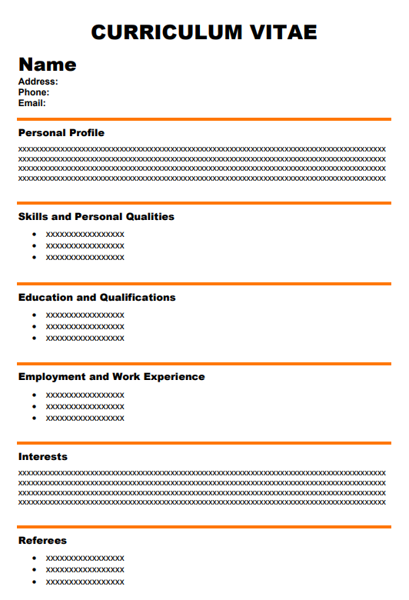
Your Name and Contact Details
CV LAYOUT & CONTENT
Check all spelling and make sure you have a professional sounding email address
Fill in this simple template throughout the sessions
Currently your CV will focus on your SKILLS and PERSONAL QUALITIES
It will develop over time as you build up more work / life experience and complete your qualifications.
Personal Profile
What makes YOU you?
Skills and Personal Qualities
How do your skills fit the job?
Education and Qualifications
Add these as you go
Employment and
Work Experience
Focus on the experience to match the job
Interests
Show the ‘whole’ YOU
Referees
Ask people that know you well and can back up what you say on your CV

Slide 7
CLICK HERE TO WATCH

Slide 8
2.38 million students studying at UK higher education institutions.
How can I write about myself?
I’m not sure who I am?
WRITING YOUR PERSONAL PROFILE
You will continue to develop your personal profile as you gain more experience and self-awareness.
Writing this now will help prepare you to write your personal statement for application to college, an apprenticeship or university.
I don’t have anything to write!
What are my achievements?

Slide 9
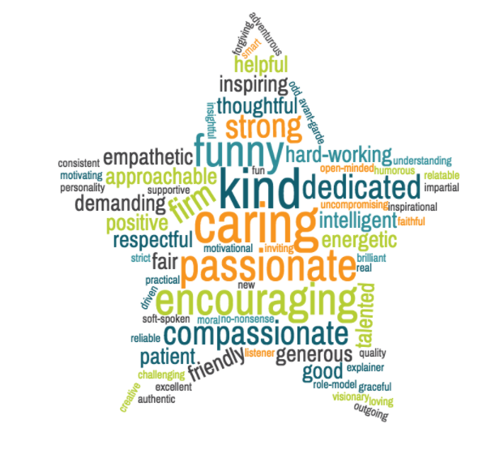
Fill in your ALL ABOUT ME positive A-Z sheet Complete as many as you can.
Start with the POSITIVES!
Use lots of POSITIVE adjectives
Name your: Experience Achievements Unique qualities

Slide 10
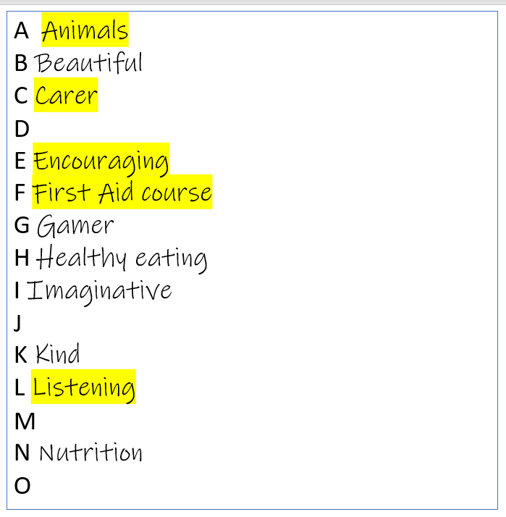
Choose your top 5 positives to showcase in your personal profile
Now describe yourself in
1 minute to a partner using your top 5

Slide 11
Personal profile I am a CARING person who is always available to LISTEN to others if they need help. I am responsible for looking after my family dog and ENCOURAGE others to be thoughtful about ANIMAL welfare. I’ve recently completed a St John’s Ambulance FIRST AID COURSE because I want to be able to help in an emergency situation.
Use this information and talking task to write a paragraph in the personal profile space on your CV template.
What impression does this personal profile give to an employer?

Slide 12
Personal profile / statement
I have excellent time management skills. I currently have a part-time paper round. This means I need to manage my time effectively to be able to complete my round, and be at school on time. I enjoy this responsibility.
I am a hardworking and motivated person, I try to achieve high standards in activities both in and out of school. The subjects I currently enjoy the most are art, IT and design & technology. These subjects allow me to use my creative skills and develop new ideas.
Examples of good personal profiles
MOTIVATION / TIME MANAGEMENT
CREATIVITY / ORIGINALITY / PROFESSIONALISM
I am currently captain of my local football team. I have been part of this team for two years. This role has given me the opportunity to develop my confidence in a leadership role. I am able to give clear instructions and support the team to work together.
I am efficient in the use of IT. I have varied experience and knowledge of using word processing and presentation software. I recently designed an IT game using RPG Maker XP. This process gave me the opportunity to apply my creative skills as well as my technical ability in game design.
What skills do they show?
LEADERSHIP / CONFIDENCE / FOLLOWING INSTRUCTIONS
INFORMATION TECHNOLOGY / CREATIVITY / TECHNICAL SKILLS

Slide 13
Do’s and Don'ts of a successful CV…
Be positive and sell yourself.
Highlight your relevant skills and experience.
Use evidence.
Be brief and to the point.
Check spelling and grammar.
Change your CV to match each job you apply for.
Align your skills and experience to what the employer is looking for based on the job advert.
Lie
Use more than two pages or cram it all into one.
Include your date of birth, gender, orientation, marital status, religion or nationality*
Leave gaps in your school or work record.
Have any spelling or grammar errors.
*Employers cannot ask for these or base decisions on them.

Slide 14
Thank you
Teachers
CLICK HERE
to give us your feedback

Slide 15
@win_wessex1
@WINWessex1
www.facebook.com/WINSUPPORTtogether
Disclaimer. Each ‘Lesson in a Box’ comes with a feedback form for you to complete. We ask that all who request and deliver a Lesson in a Box to complete this feedback form to ensure that we are providing the highest quality resources possible. Please note, we may contact you if we have not received a response on this feedback after a certain amount of time.

