Slide 2
PRE-16
INTRODUCTION TO HIGHER EDUCATION

Slide 3
2.38 million students studying at UK higher education institutions.
Session 1
WHAT IS
HIGHER EDUCATION?
What skills will I learn?
Will it help me get a job?
Can
anyone
go?
What will I study?

Slide 4
2.38 million students studying at UK higher education institutions.
NOT ME
ME
Starter Questions
SHOW OF HANDS
1.
Who already knows something about Higher Education/university?
Who is already considering going onto further study after school or college?
ME
2.
NOT ME

Slide 5
What’s happening in this photo?

Slide 6
CLICK HERE TO WATCH

Slide 7
How many universities do you think there are in the UK?
There are 330 Universities and colleges in the UK
Fact Checker
Questions:
Answers:
How many courses do you think there are to choose from?
There are 37,000 different courses to choose from
How many students do you think are currently at University in the UK?
Currently there are 2.38 million students studying in Higher Education in the UK

Slide 8
Higher Education is your degree level learning after you leave school or college, aged 18.
You can study at a university or college or do an Apprenticeship where you work (and study).
Anyone can go to university at anytime in their life.
Explainer:

Slide 9
2.38 million students studying at UK higher education institutions.
HOW DO I
GET THERE?
How long does it take?

Slide 10
There are many different pathways to degree level, it’s not always a straight line.
Learning is life-long and you can hop on and off your path.
Explainer:

Slide 11
LEVEL 1/2
LEVEL 3
LEVELS 4/5/6/7/8
THE REST OF
YOUR LIFE
YEAR 9
YEAR 10/11
YEAR 12/13
HIGHER EDUCATION
SCHOOL
SCHOOL
SCHOOL OR
FE COLLEGE
UNIVERSITY OR COLLEGE
WORK
Year 9
(Options)
GCSE’S
Traineeship (or other pathways)
A levels
HNC / Higher Apprenticeship
Work and study
(on-going)
Advanced Apprenticeship
Work and training
(on-going)
Foundation Degree / Dip HE
NVQ
HND / Degree Apprenticeship
BTEC Certificate
1 yr
PGCE - Teaching
YOU ARE
HERE
Bachelors Degree
BA / BSC
BTEC Diploma
2yrs
OR
HERE
Masters Degree
MA
T Levels
Doctorate PHD

Slide 12
You may decide to study A Levels after you’ve finished your GCSE’s.
Or you might go on to college and take a BTEC, T level, Apprenticeship or other qualifications that are right for you.
Explainer:
Don’t worry, all schools and colleges have experienced Careers Advisors who can help with your choices.

Slide 13
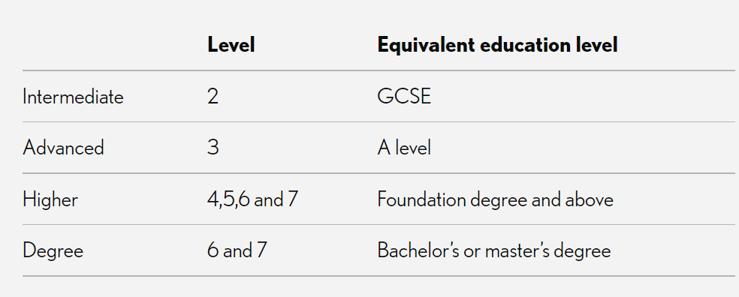
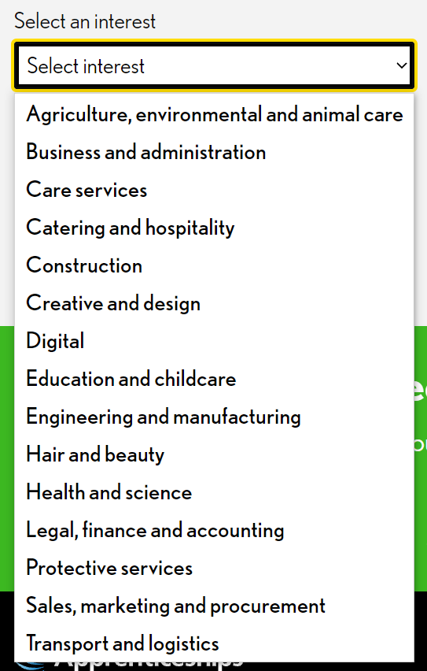
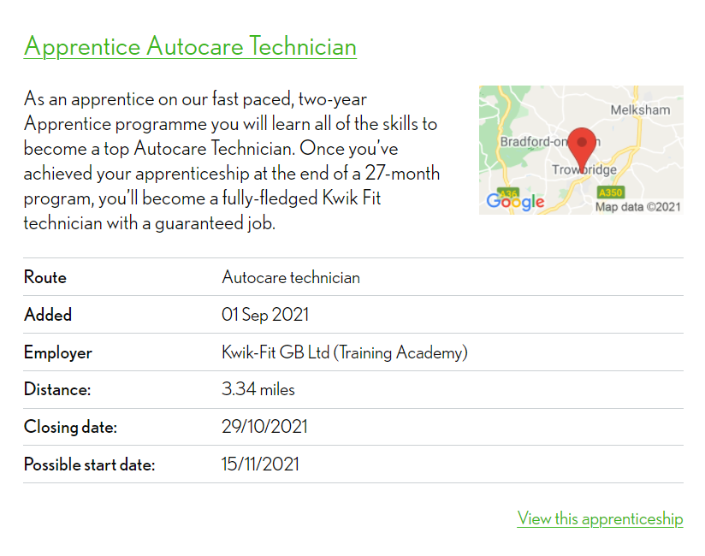
You may decide that you want to work
and study on an Apprenticeship.
An Apprenticeship is funded by the government and your employer.
You’ll earn a wage, receive time off and gain skills and experience in your chosen career.
There are many Apprenticeships depending on your interests:
CHECK OUT APPRENTICESHIPS INFO AND OPTIONS HERE

Slide 14
CLICK HERE TO WATCH

Slide 15
2.38 million students studying at UK higher education institutions.
I think I might try uni?
WHAT DOES A UNIVERSITY
LOOK LIKE?
Where will
I study and live?

Slide 16
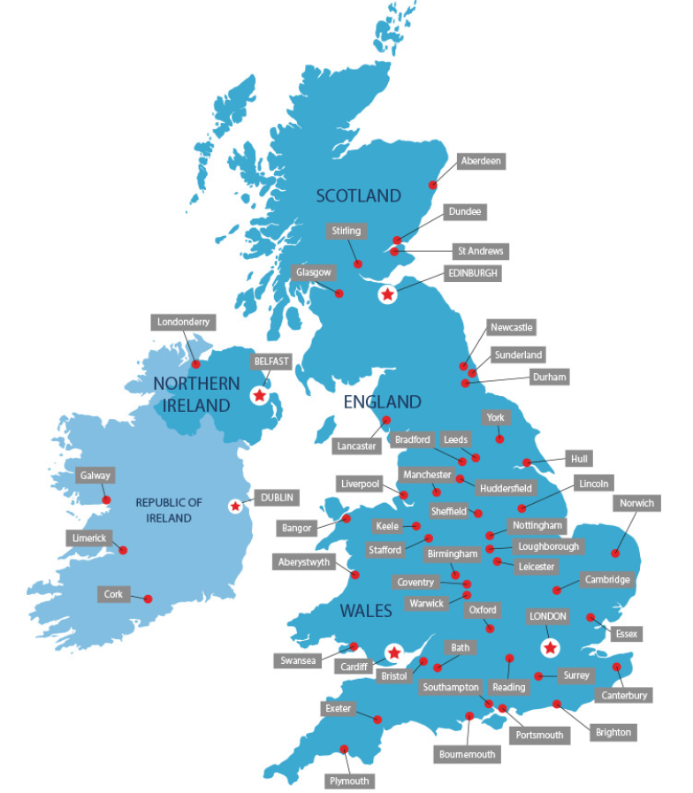
There are many different types of university all over the country.
CHECK OUT WIKIPEDIA FOR A FULL ALPHABETICAL LIST OF ALL UK UNIVERSITIES

Slide 17
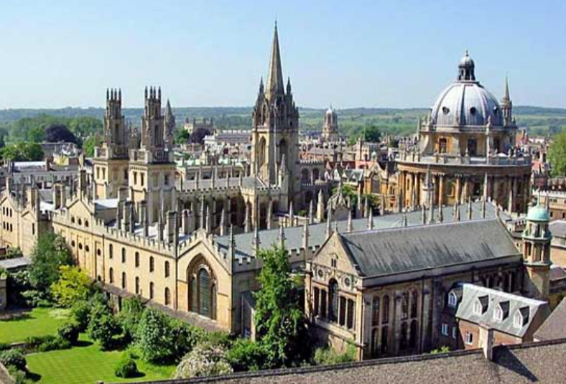
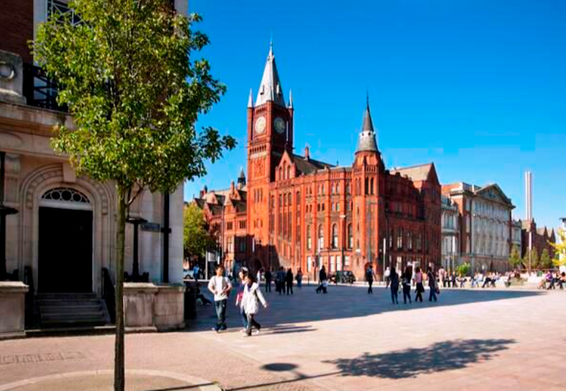
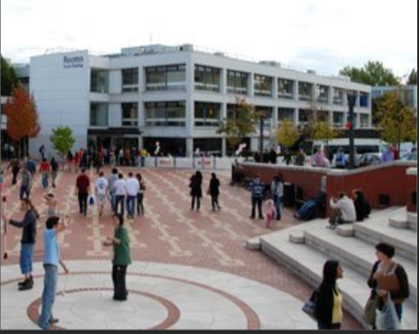
You might go to an ANCIENT UNIVERSITY like Oxford or Cambridge.
You might go to a RED BRICK or CITY UNIVERSITY like Birmingham, Liverpool or Sheffield.
You might live and study on a Campus or in a town or city.
You might go to a CAMPUS UNIVERSITY like York, Warwick or Sussex.
You might go to a NEW UNIVERSITY like Bath Spa, Teesside or Sunderland.
SEE STUDENT ROOM FOR A FULL BREAK DOWN OF UNIVERSITY TYPES

Slide 18
CLICK HERE TO WATCH

Slide 19
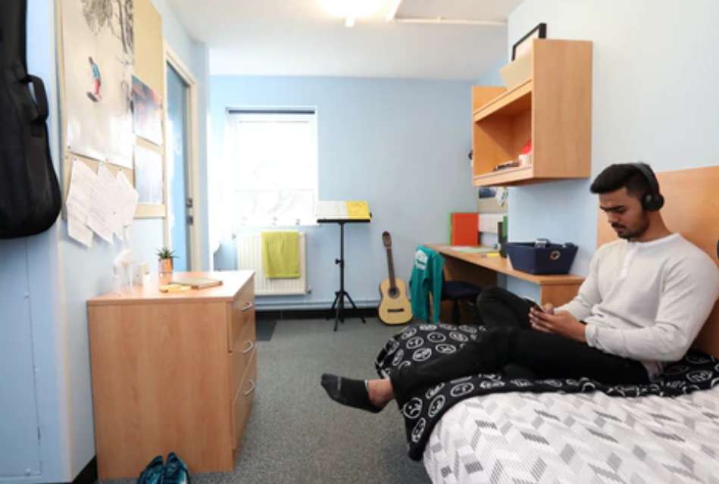
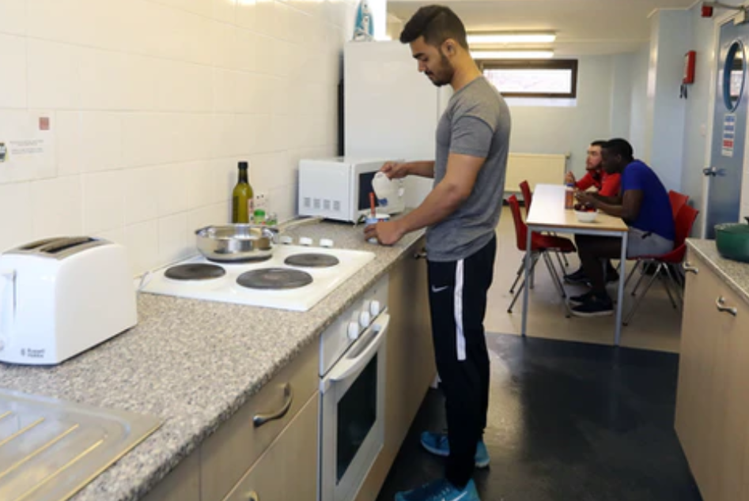
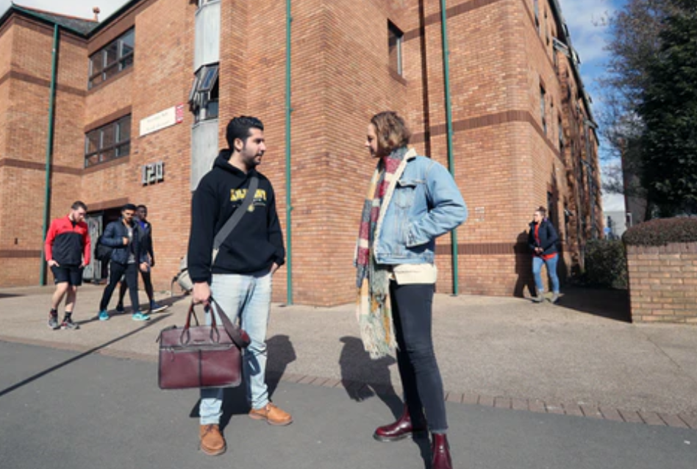
Where were these photo’s taken?

Slide 20
Thank you
Teachers
CLICK HERE
to give us your feedback

Slide 21
@win_wessex1
@WINWessex1
www.facebook.com/WINSUPPORTtogether
Disclaimer. Each ‘Lesson in a Box’ comes with a feedback form for you to complete. We ask that all who request and deliver a Lesson in a Box to complete this feedback form to ensure that we are providing the highest quality resources possible. Please note, we may contact you if we have not received a response on this feedback after a certain amount of time.

