Slide 2
MY STUDY SKILLS
UNDERSTAND HOW TO REVISE EFFECTIVELY

Slide 3
TODAY WE WILL:
Think about how you can make your revision effective
Plan a revision timetable
Explore revision strategies and techniques

Slide 4
How can you make revision effective?
Plan when and where you are going to revise
Plan how you are going to do it (which strategies are you going to use?)
Reflect and evaluate your progress

Slide 5
Walking the dog
Washing up
Football training
Helping round the house
On my phone (BE HONEST)
Netflix
Picking up my brother from after school club
First, plan when and where you are going to revise
Where Does
My Time Go?
Note down all activities you do daily outside of school
Note down all activities you do daily outside of school
Note down all activities you do daily outside of school

Slide 6
look at your exam timetable and start revising in that order
Leave yourself plenty of time! The more you can go over the information, the more you will remember it in your exams
Do you find in easier to start with the trickiest subjects/topics or the ones you find easier to give you confidence?
Think about who can support you – teachers, parents and carers

Slide 7
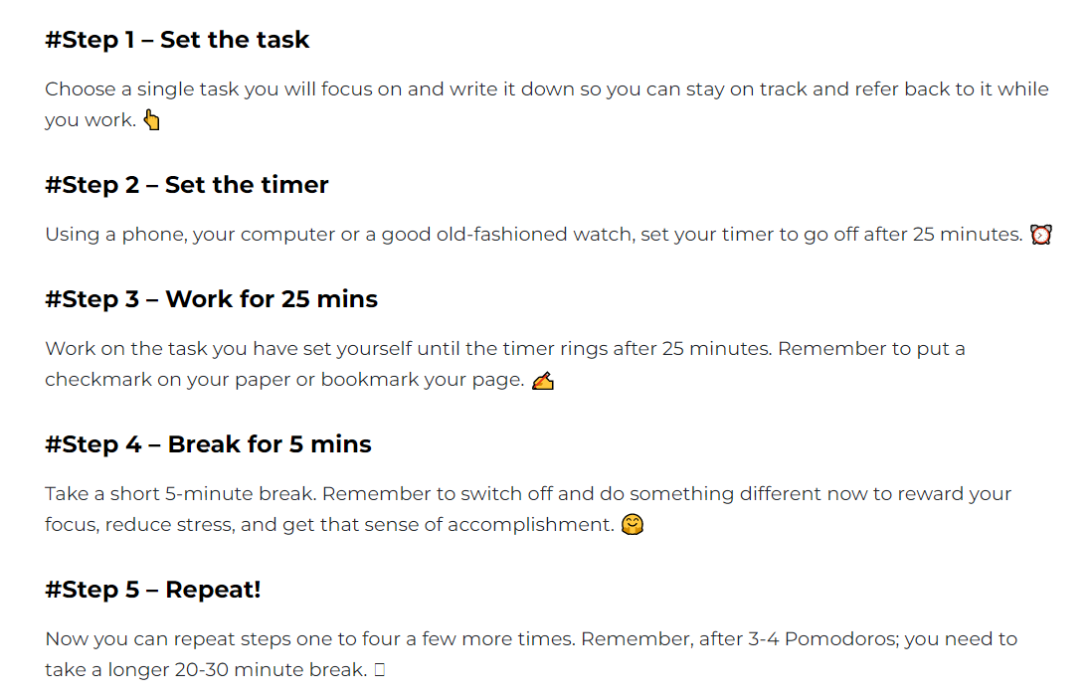
Top tips
Consider using the ‘Pomodoro technique’ to manage your time – if you find it hard to focus for long periods of time, this could really help you!
Notes:
The idea behind the method is that by breaking down the time into manageable chunks, you will be able to focus better on the task at hand, knowing you will soon have a break. Could this

Slide 8
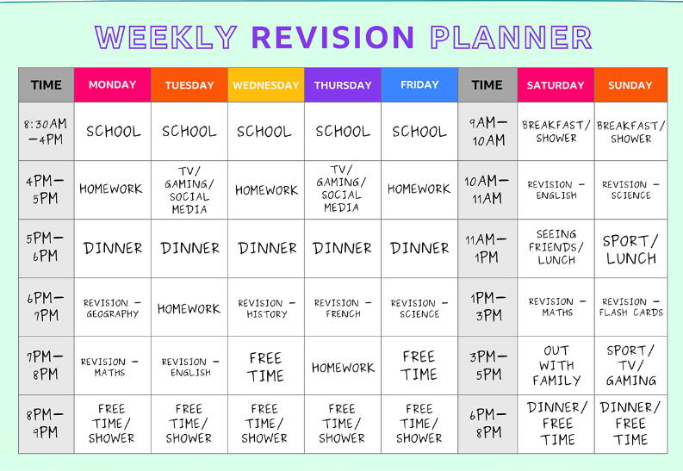
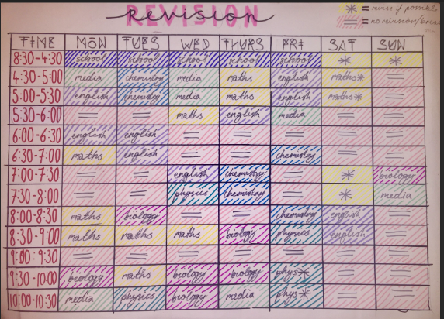
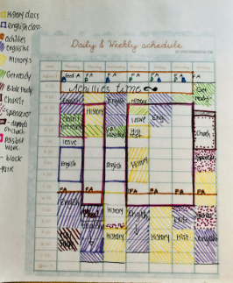
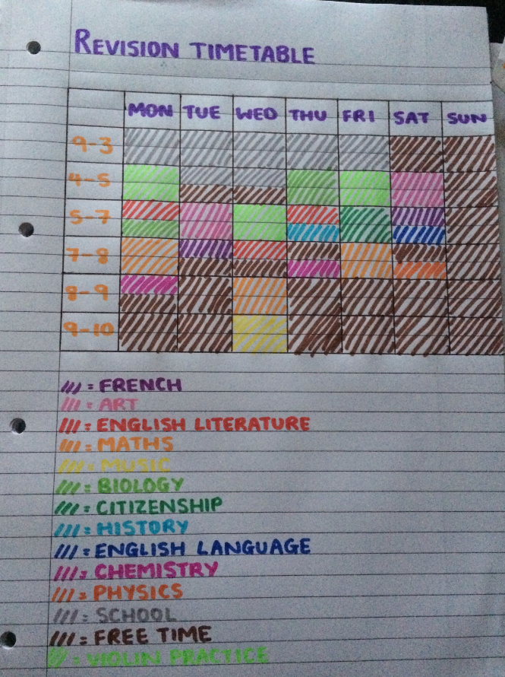
START BY PUTTING YOUR FREE TIME INTO YOUR PLANNER THEN ADD YOUR REVISION SESSIONS:
MAKE IT YOUR OWN

Slide 9
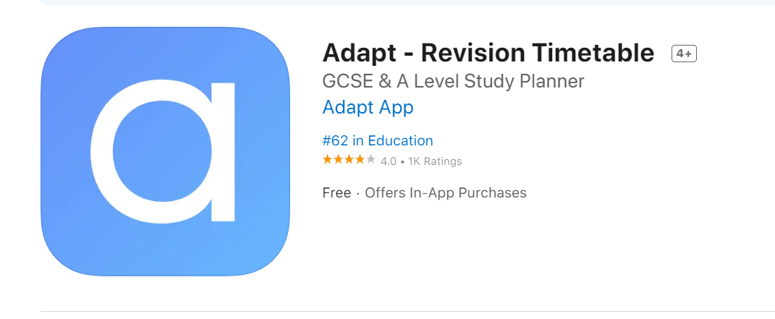
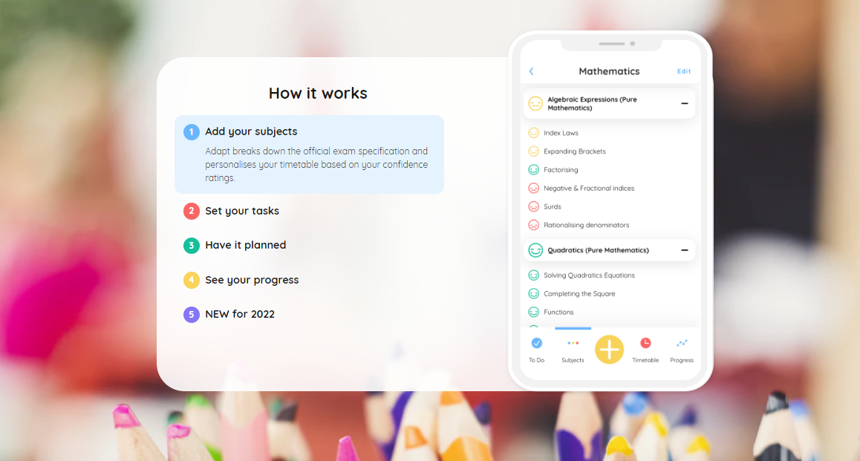
ADAPT APP
Notes:
Some students may find this useful – knows the exam bards and dates so can plan out a revision timetable for you and sets you daily task. Could be overwhelming for others so bare this in mind

Slide 10
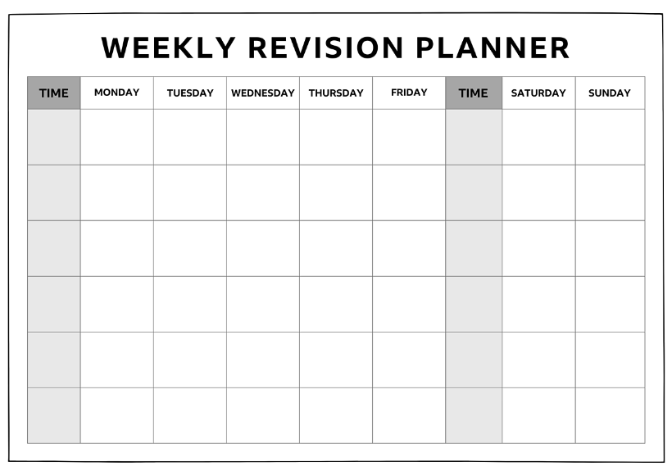

Slide 11
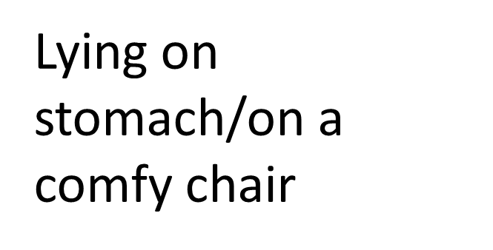
Where are you going to revise?
Consider where there is a quiet space to revise. Your room may not be the best place as it is good to separate your work and rest space
Some music in the background (instrumental)
Quiet space

Slide 12
Strategy 1
Feynman Technique – study method for students to learn through the act of teaching
4 Steps
1.Choose what you are going to learn about
2.Explain it in simple terms (like you would to a child. Remove any jargon and complexity)
3. Reflect and refine (Read it out loud as if to a child. If the explanation isn’t simple enough or sounds confusing, that’s a good indication that you need to reflect and refine.)
4. Organise and review (test it on someone, what did they get confused about? What questions did they ask? Once you are happy with your explanation add it to your notes or flashcard to refer back to)
Einstein

Slide 13
Your turn!
‘Explain’
In your pairs chose a subject and describe it in a minute.
Imagine your partner knows nothing about the subject.
How can you explain it in the simplest terms?
Explain climate change
Explain what a pandemic is
Explain how to make a cake
Explain your personality
Explain how you get to school
Notes:
How easy did they find this? If you can explain it simply to someone else, that demonstrates your understanding

Slide 15
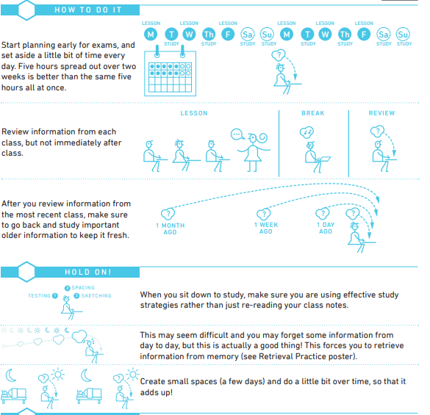
Spaced practice
Strategy 2
review, practice, recall, formulate and synthesize the same materials multiple times.

Slide 16
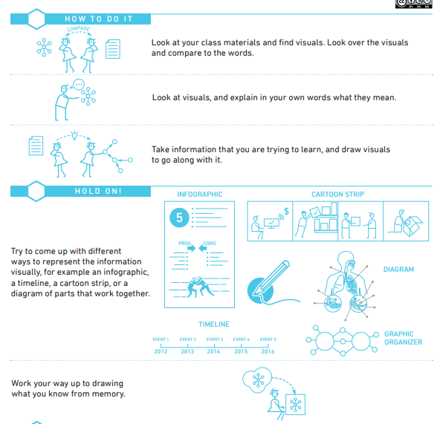
Dual coding
Strategy 3
Using visuals alongside information

Slide 17
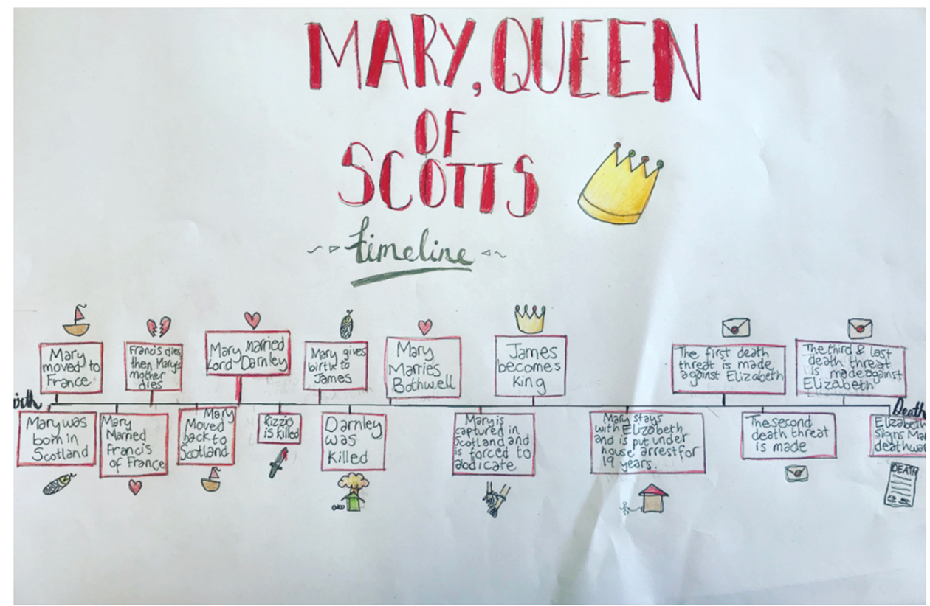
Dual coding
Strategy 3
Using visuals alongside information.
For example a timeline.
You can see here how the student has used pictures alongside words.
This gives you 2 ways to remember the information

Slide 19
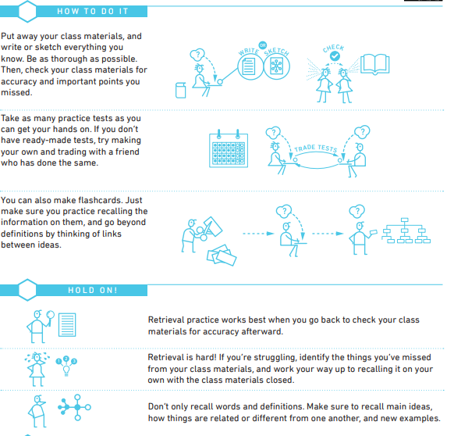
Retrieval Practice
Strategy 4
engage with the material in an active way rather than passive learning i.e. testing knowledge

Slide 20
3 stages of metacognition
awareness and understanding of one's own thought processes.

Slide 21
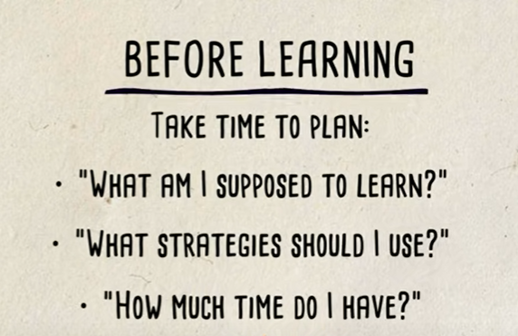
Stage 1

Slide 22
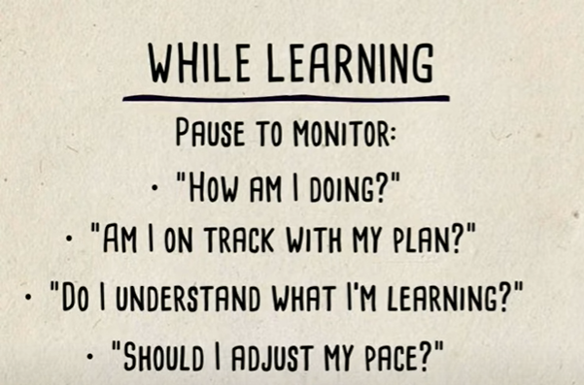
Stage 2

Slide 23
Stage 3

Slide 24
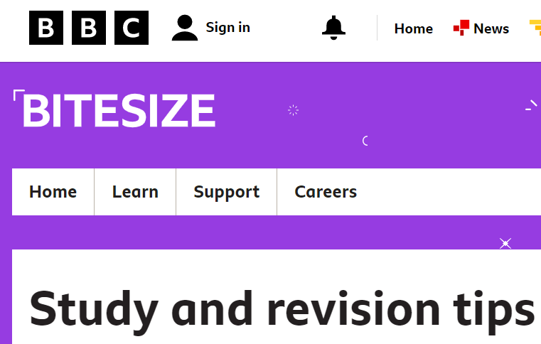
1.) Where are you going to study?
2.) What kind of environment do you work best in? (quiet/background music etc)
3.) Which strategy are you going to incorporate and how?
Answer the following questions:
Useful websites :

Slide 25
@win_wessex1
@WINWessex1
www.facebook.com/WINSUPPORTtogether
Disclaimer. Each ‘Lesson in a Box’ comes with a feedback form for you to complete. We ask that all who request and deliver a Lesson in a Box to complete this feedback form to ensure that we are providing the highest quality resources possible. Please note, we may contact you if we have not received a response on this feedback after a certain amount of time.

